Slide 1
Constitutive Artificial Neural Network Coding Workshop
Skyler St. Pierre (they/them)
Kevin Linka, Ellen Kuhl
September 13, 2023
Summer School Graz

Slide 2
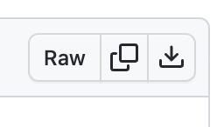


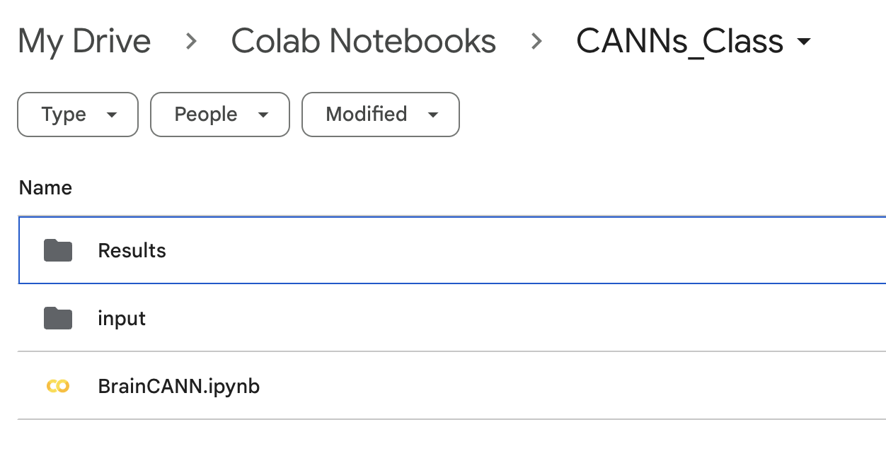
Download from Github
upload to Google Drive and place all info into the same folder e.g. GrazWorkshop
create a folder named `input’ to place the Excel file in

Slide 3
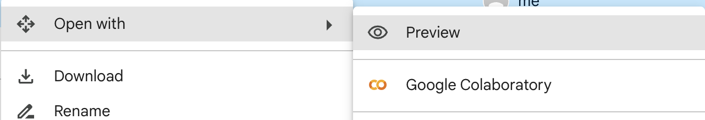
Google Colab
No installations required to run – all cloud-based computing

Slide 4
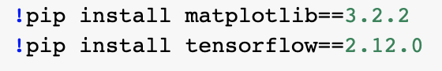
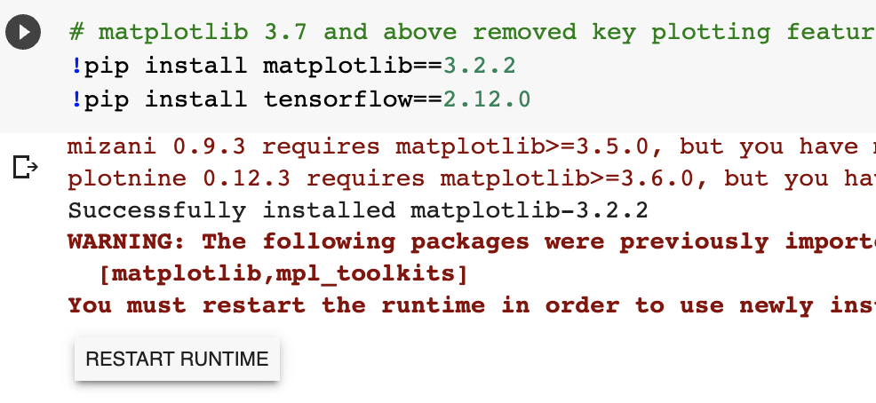
0. Load packages
make sure to click restart runtime after installation finishes
can also go to runtime > restart runtime

Slide 5
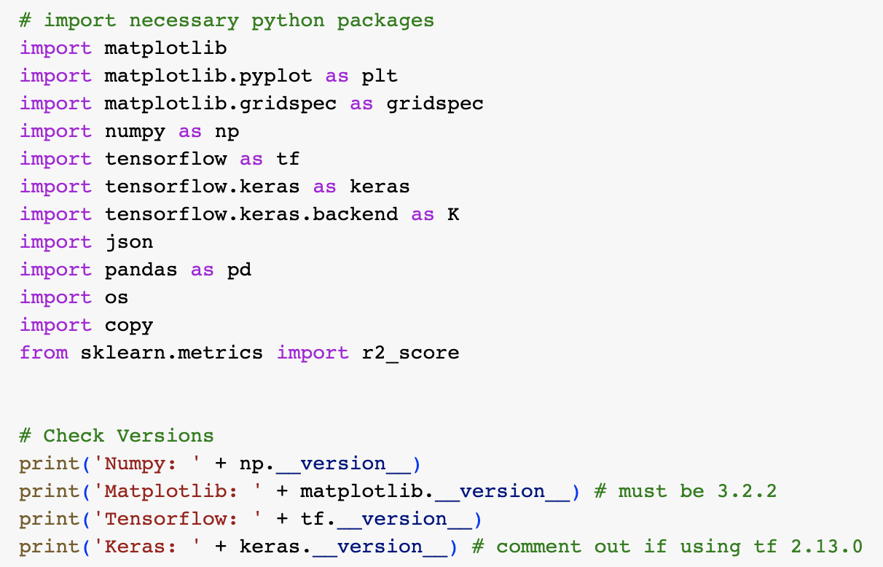
0. Load packages
matplotlib: plotting
numpy: math functions
tensorflow: neural network
pandas: data manipulation from csv/excel file
sklearn: data analysis functions
Double-check the matplotlib version is correct (3.2.2) or this code will not work!

Slide 6
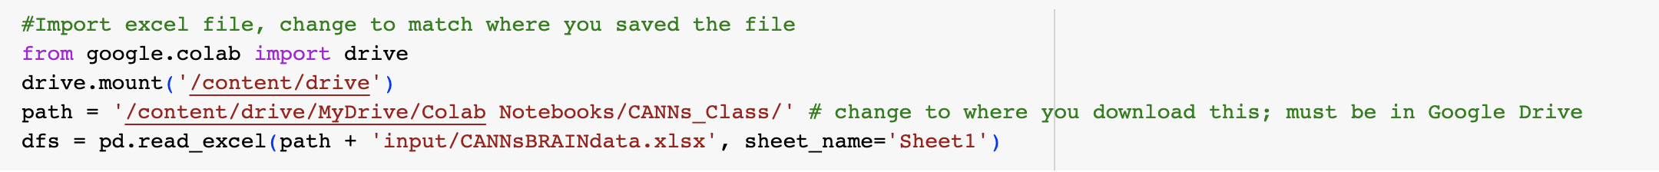
Using Colab
change `path’ to the location where you uploaded the input folder and code in Google drive

Slide 7
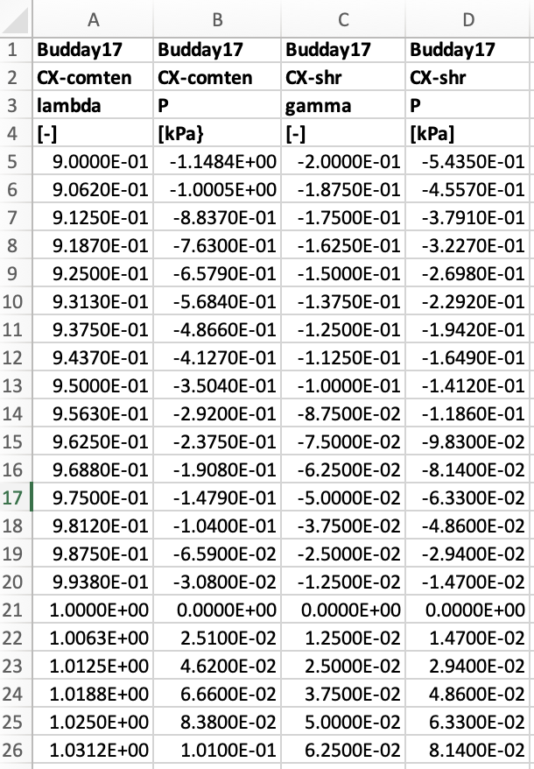
1. Load Data
uniaxial stretch
uniaxial stress
amount of shear
shear stress
pandas reads first row as header
data starts at index [3] when reading in file
zero stretch/stress
shear is symmetric

Slide 8
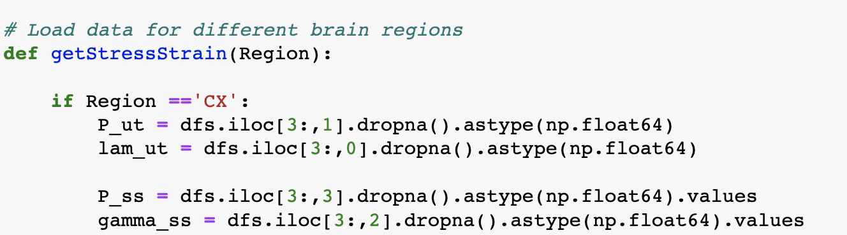
.dropna() means all empty cells aren’t included
returns lambda, P11 (uniaxial stress), gamma, P12 (shear stress) data for each region when called

Slide 9
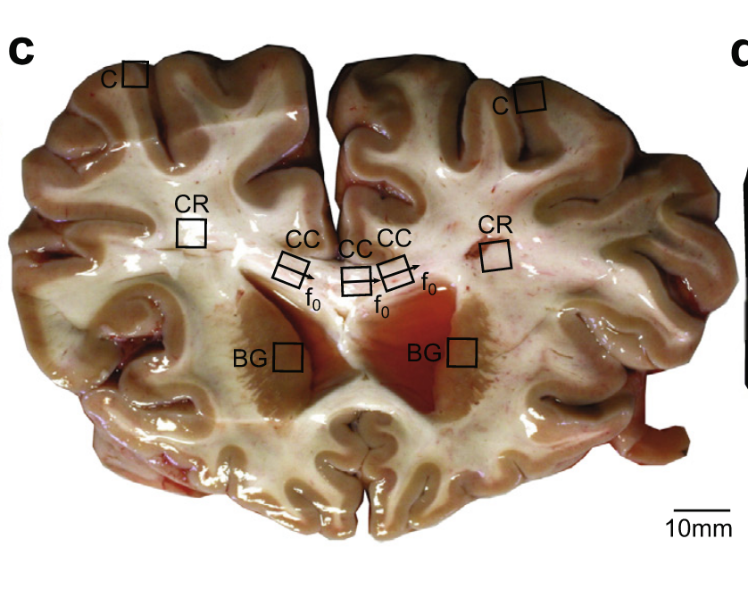
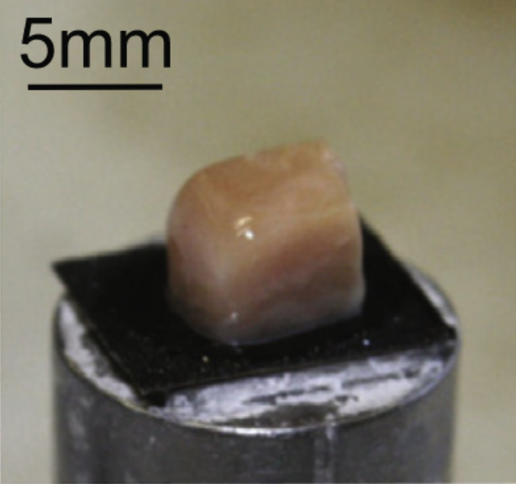
Brain tissue assumptions: isotropic, incompressible
tension
compression
shear
Grey matter: cortex (C), basal ganglia (BG)
White matter: corona radiata (CR), corpus callosum (CC)
Figures and data from: Budday et al., Acta Biomaterialia, 2016.

Slide 10
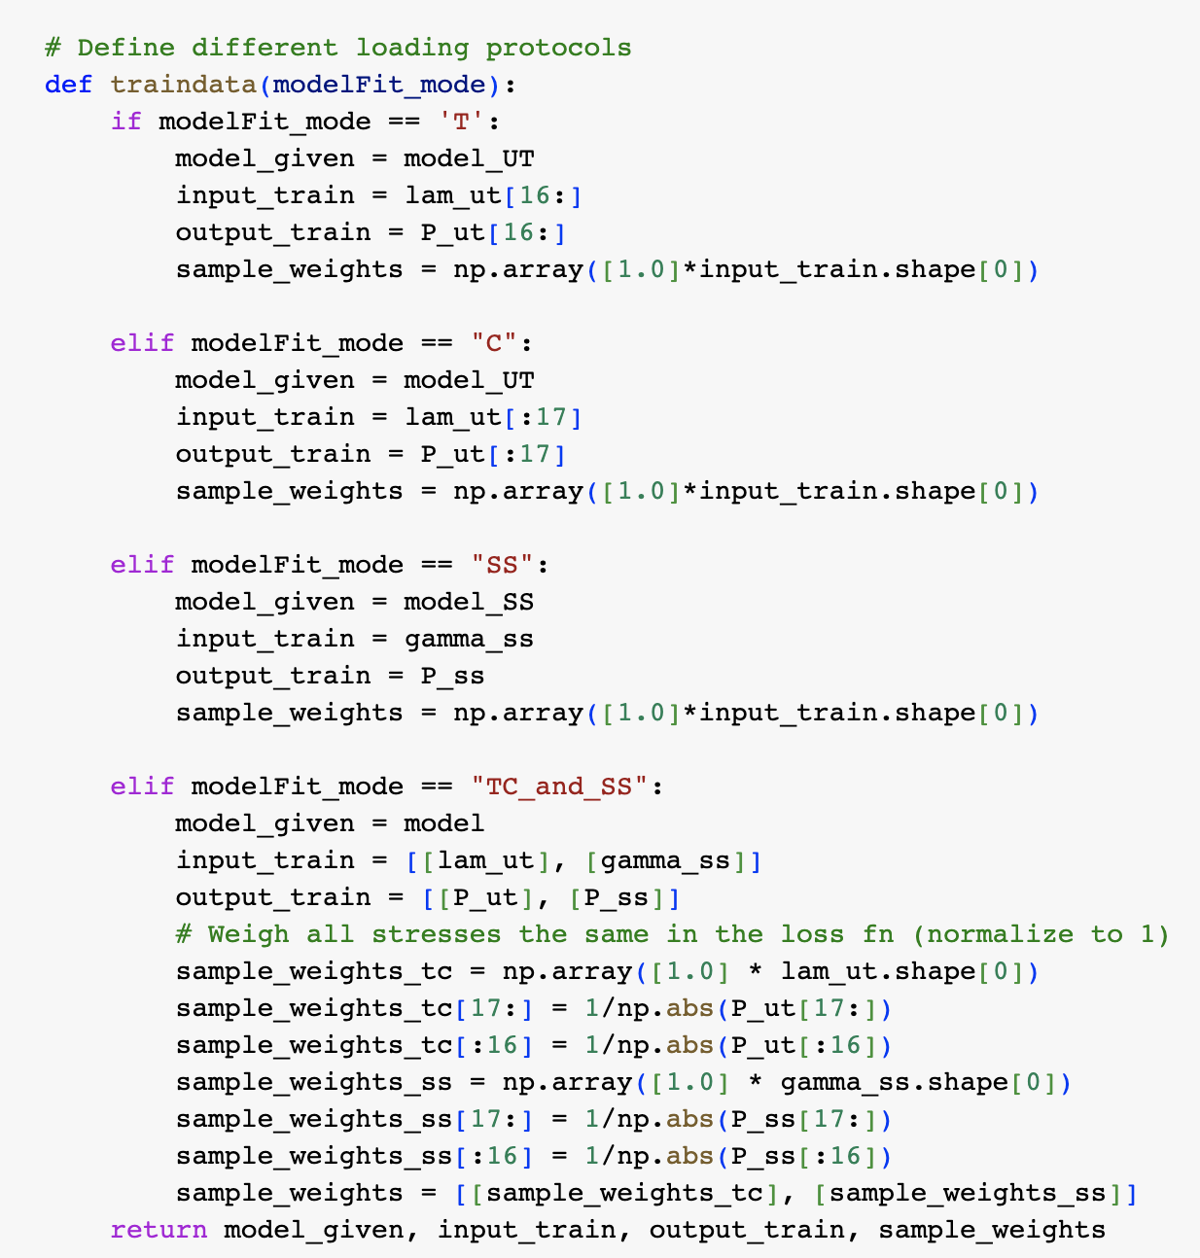
just tension data
just compression data
all samples are weighted to 1
just shear data
separate models for uniaxial data and shear data so input and output need to be two separate arrays
tension, compression, and shear
can weigh data points differently in the loss function; here we have weighted all points to 1 by normalizing by the stress value

Slide 11
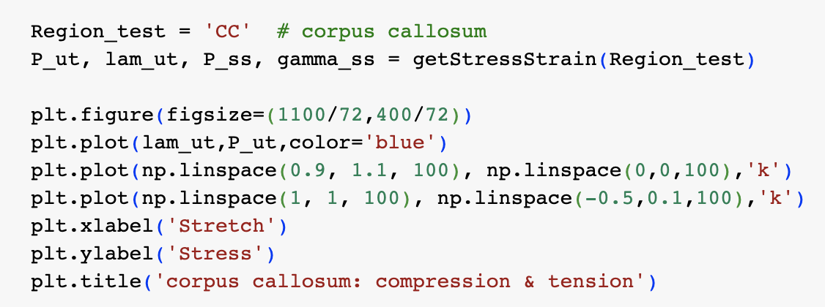
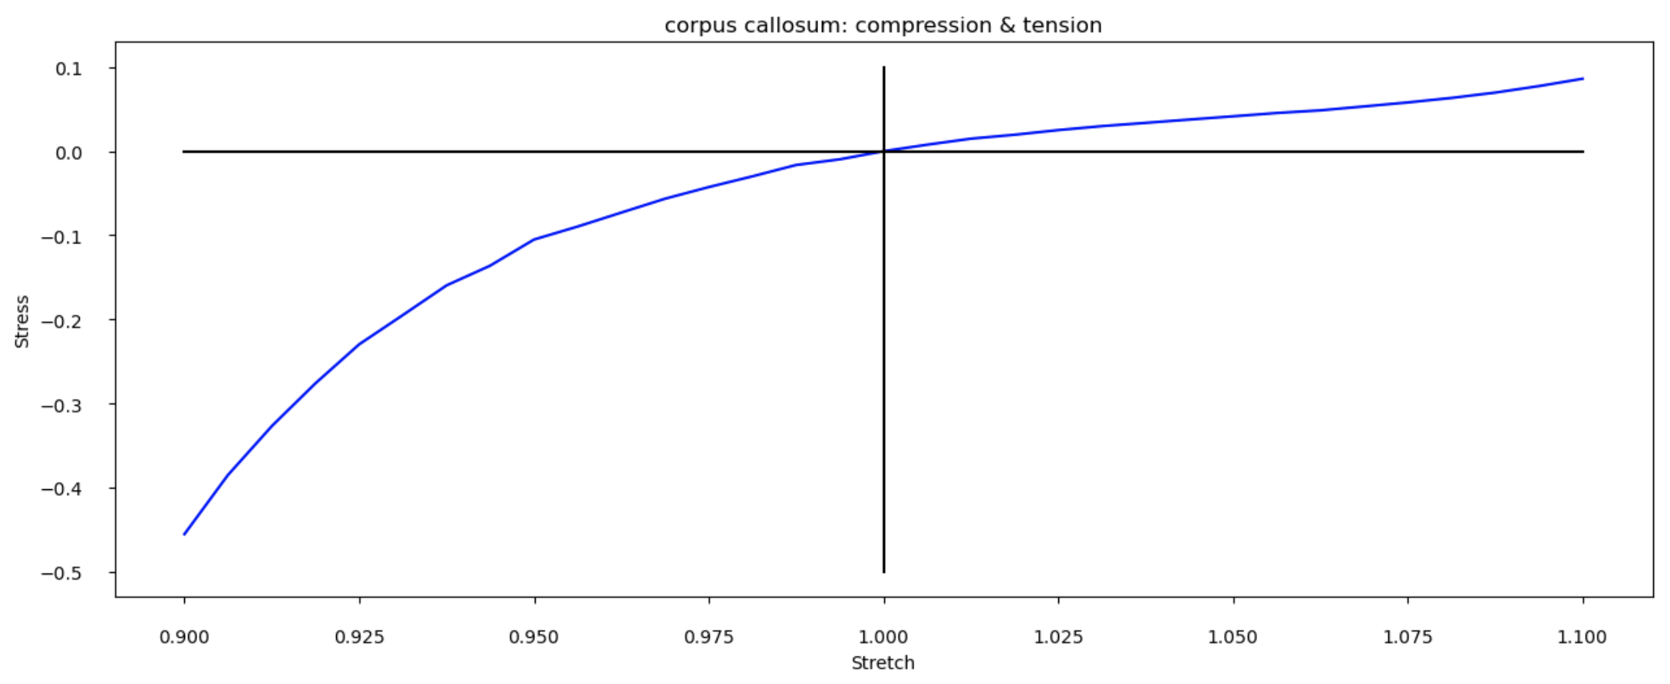
plot data for ‘cc’ region
try out different regions!

Slide 12
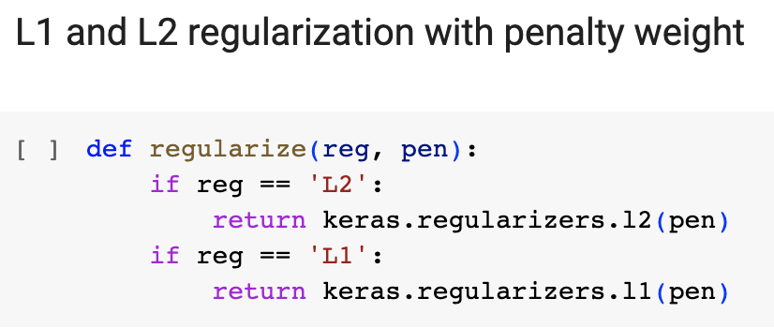
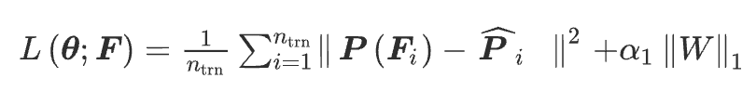
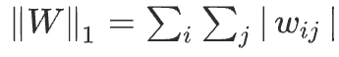
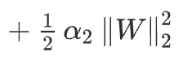
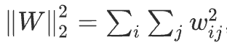
Regularization
Loss function with L1
penalty
Effect: drives some weights to zero, creates sparsity
Loss function with L2
L2 regularization: Ridge regression
L1 regularization: Lasso regression
penalty
Effect: drives all weights closer to zero

Slide 13
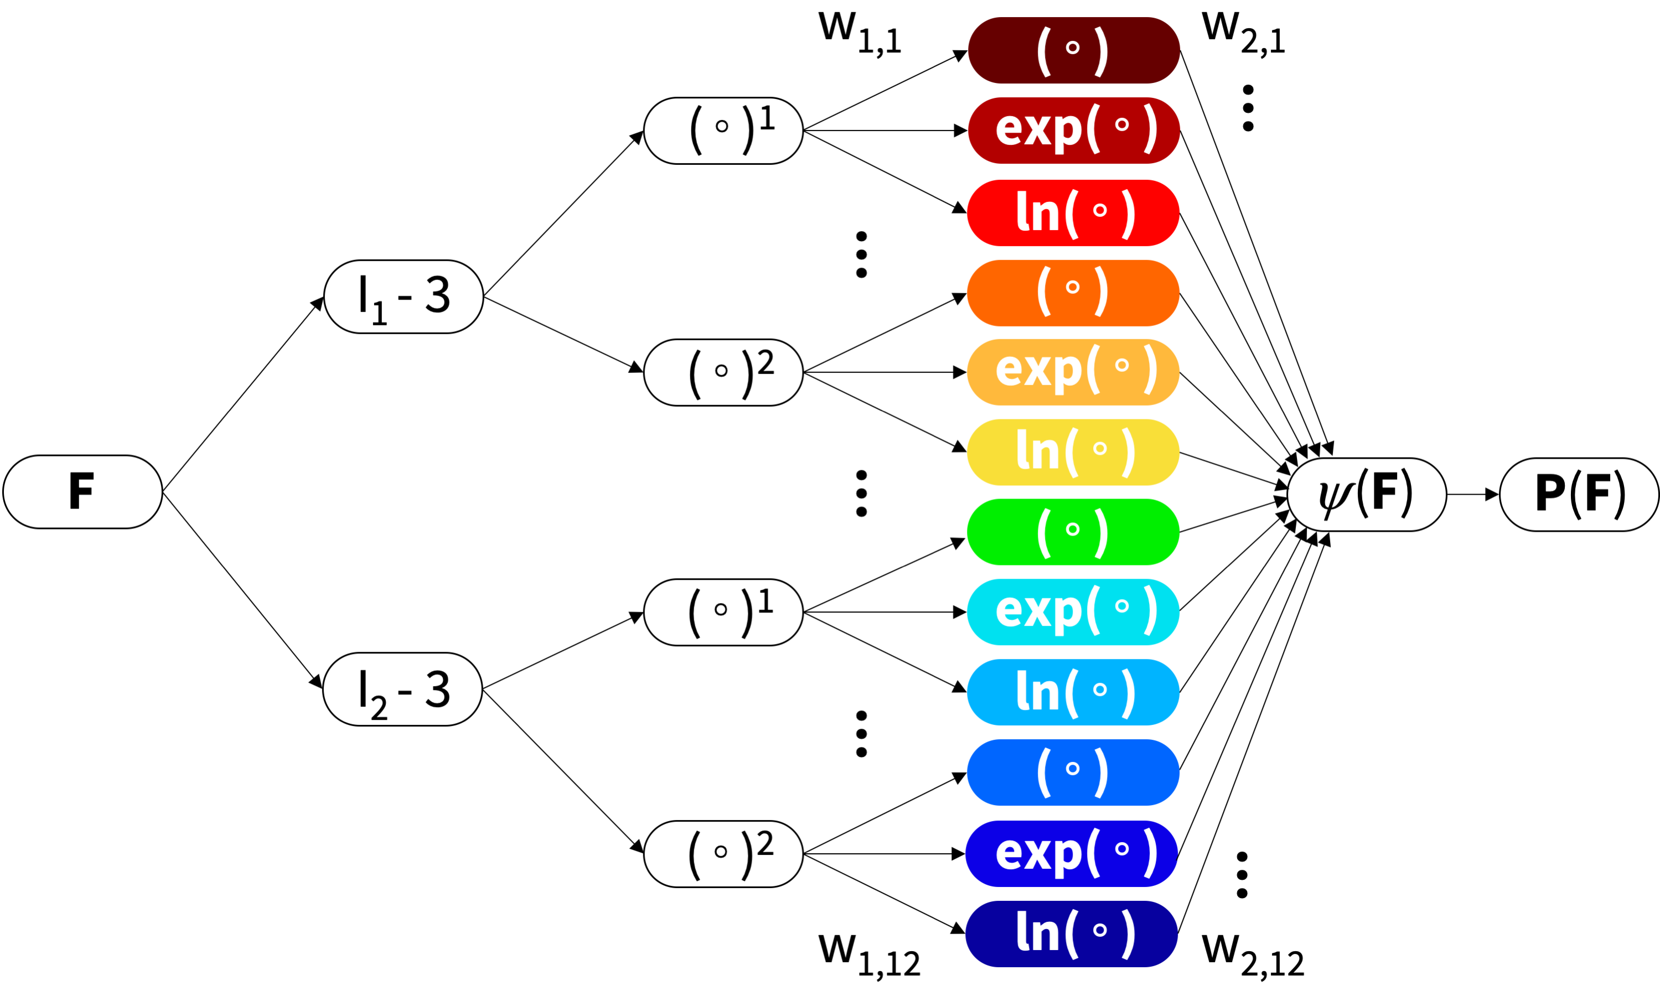
2. Constitutive Artificial Neural Networks
Invariant-based CANN¹
Principle-stretch-based CANN
-Thermodynamic consistency
-Material objectivity, symmetry, & isotropy
-Physically reasonable constraints
-Polyconvexity, Incompressibility
CANNs:
Loss function:
Physics constrained results and few parameters allows for extrapolation & interpretation
1. Linka, St. Pierre, & Kuhl, Acta Biomaterialia, 2022

Slide 14
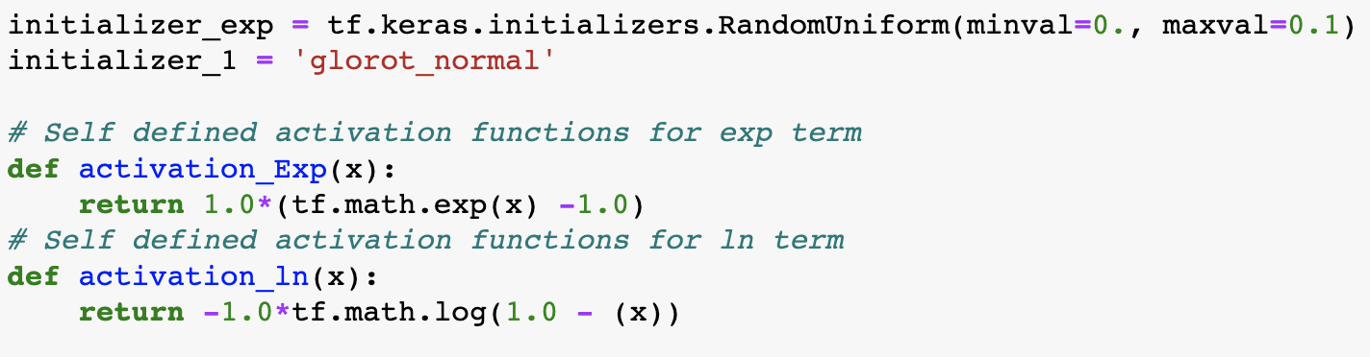
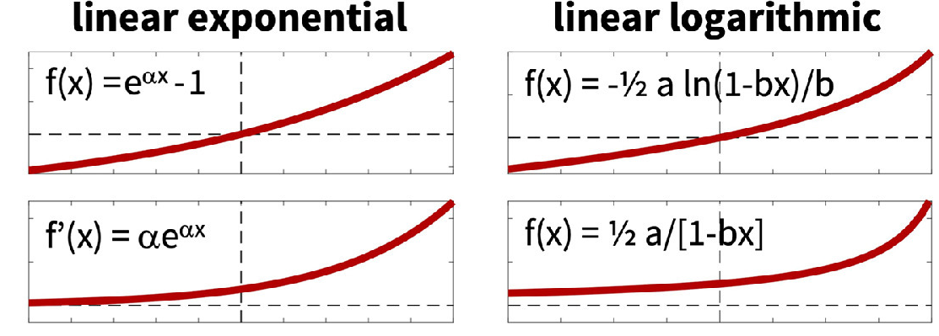
2a. Strain Energy Model – Invariant based
initializers: how to initialize weights (a random small number)
truncated normal distribution
custom activation functions
f: strain energy
f’: P (derivative of strain energy)

Slide 15
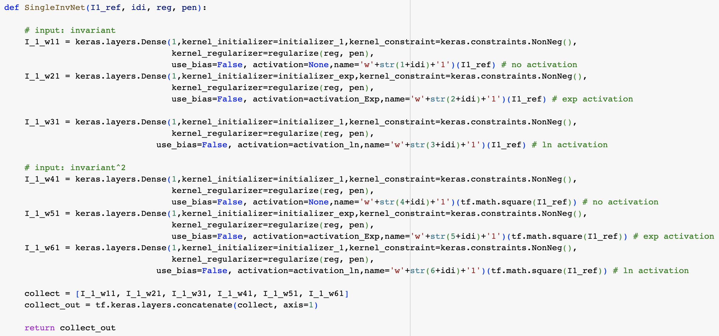
Create the terms in the first layer
regularization can be applied (L2)
weights are initialized, constrained to be non-negative
no bias terms, activation function applied (none, exp, ln)
Invariant or invariant^2 is applied
layer 1
keras.layers.Dense; kernel is the newly initialized weight
output = activation(dot(input, kernel) + bias)
I_1_w11 = none(I1_ref*W₁₁)
I_1_w21 = exp(I1_ref*W₂₁)
I1 has 6 terms
I2 has 6 terms
total = 12

Slide 16
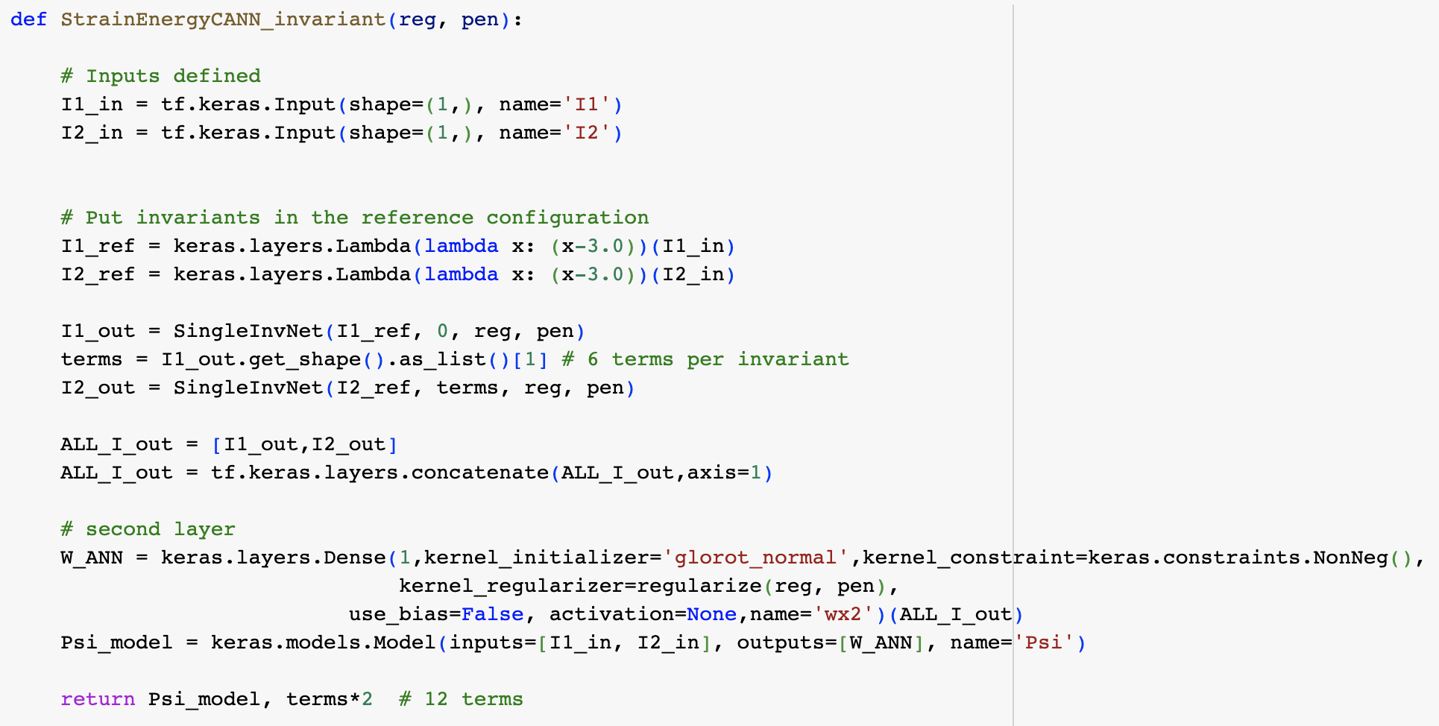
Tensorflow: create model structure
Inputs (I1, I2) - will be created in separated function, assume we have already
Shift to reference config (subtract 3)
Get terms for I1 in ref
Get terms for I2 in ref
Collect 12 terms together
Create second layer weights
Define the Psi_model with inputs (I1, I2), and output the model structure
terms*2 = 12

Slide 17
2b. Strain Energy Model – Principal-stretch based
each term is created the same way, just different exponents
no activation function
non-negative weight
can apply L1 reg is L1 is non-zero
feed in invariant in reference configuration
- this invariant will be in the form of the principal stretches

Slide 18
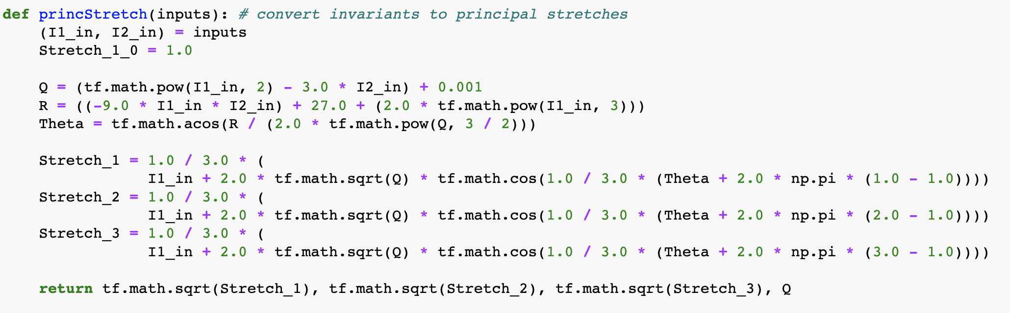
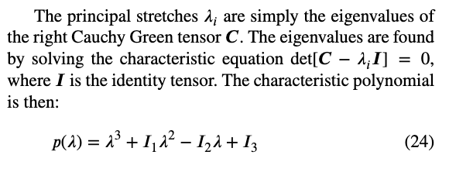
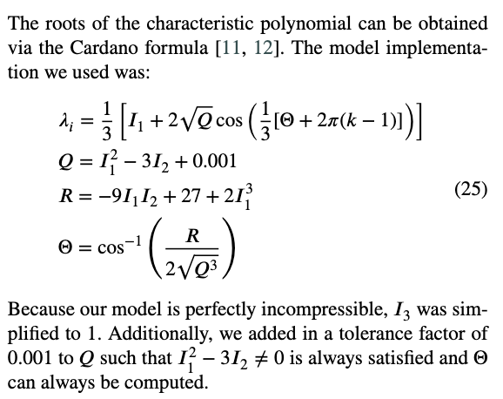
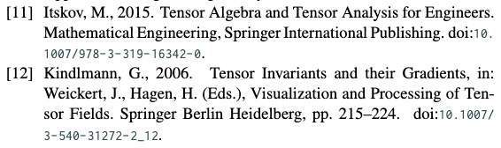
Go from invariants to principal stretches using math

Slide 19
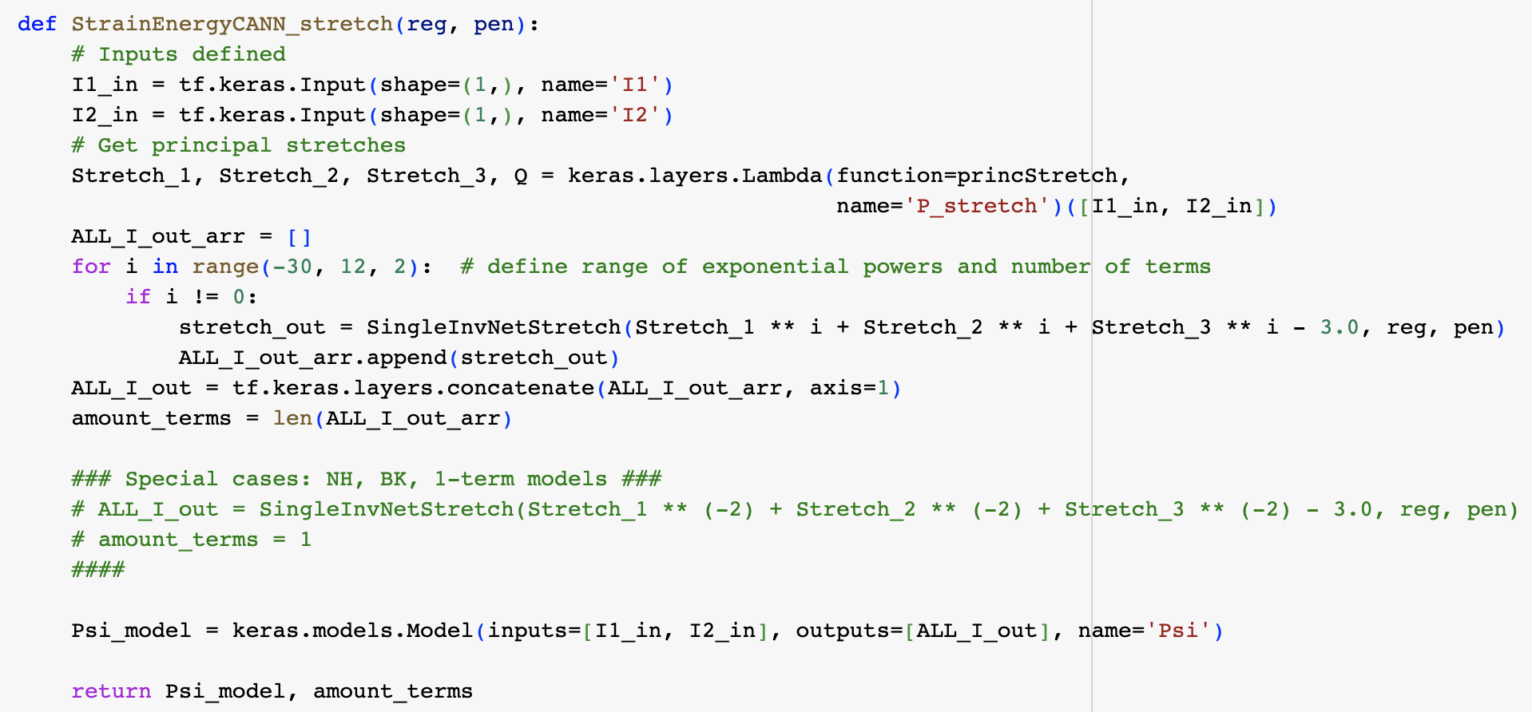
inputs: invariants
convert to principal stretches and define the range you want
feed in stretches raised to powers and subtract 3 to be in reference configuration
don’t include zero power
all terms get put together
amount_terms = 20 for this example

Slide 20
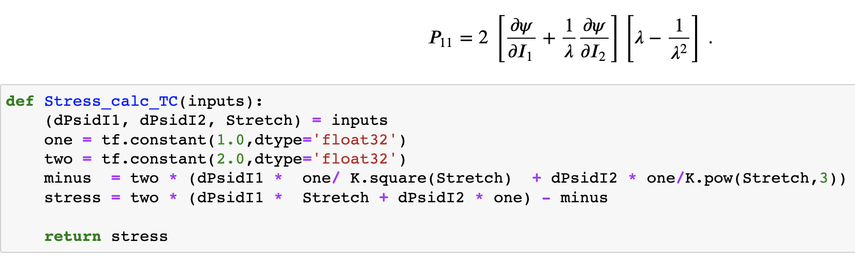
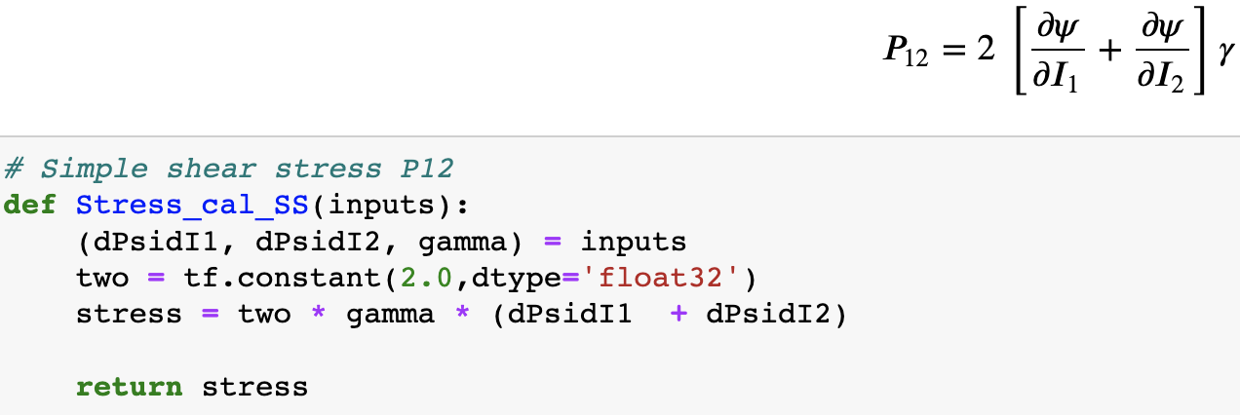
3. Stress models
define the analytical relationship between the deformation, strain energy function, and the stress
Uniaxal stress: P11
Simple shear: P12

Slide 21
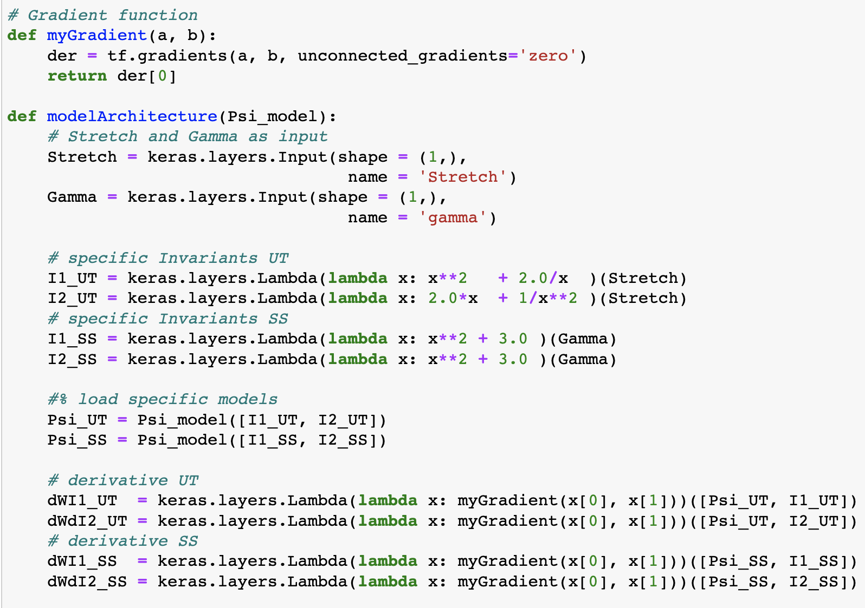
Build the model architecture using tensorflow: inputs are the Psi_model and the deformation
take gradients using tensorflow
Psi_model: invariant or stretch-based structure
uniaxial invariants
simple shear invariants
Feed UT and SS invariants into psi_model, get uniaxial and simple shear models
take derivatives of strain energy fn (Psi) with respect to I1, I2 for both UT and SS

Slide 22
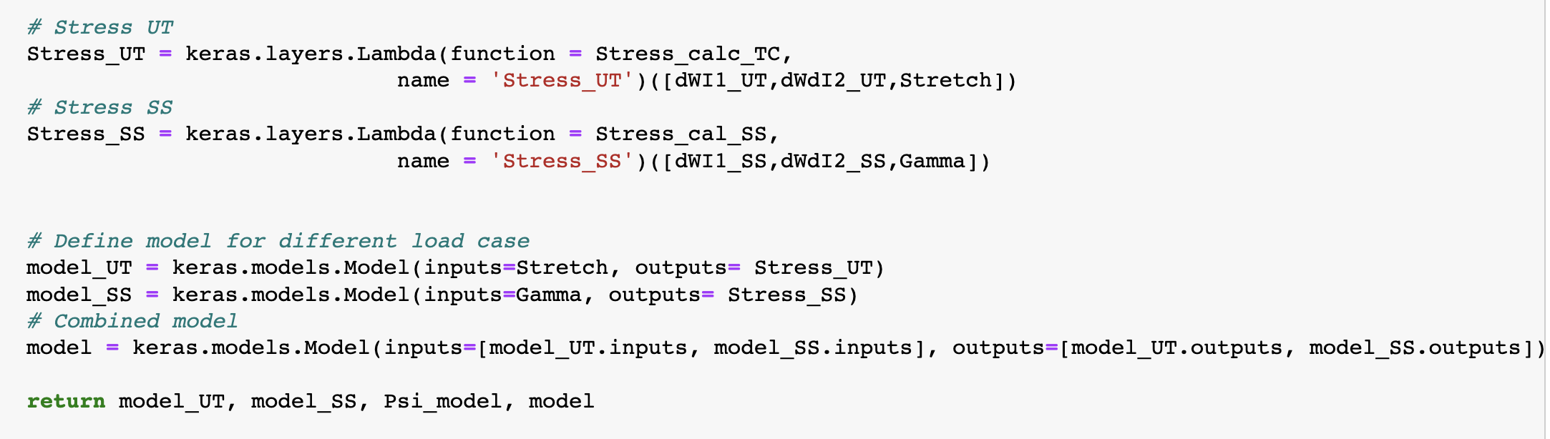
Get P11 and P12 and make into a Lambda layer so can use as output
Lambda layer: arbitrary expression made into layer
combined model
define UT, SS and combined (tension, compression, and shear) models

Slide 23
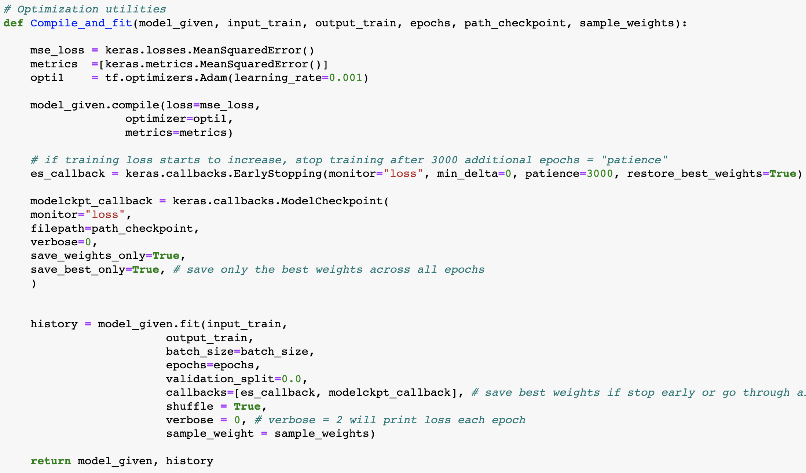
4. Compile model
define loss metric, optimizer
ES: early stopping if loss increasing instead of decreasing
model checkpoints used to save best weights
model.fit – input/output pairs of data to train on, sample_weight is how much each sample is weighted in the loss function
history variable stores the loss

Slide 24
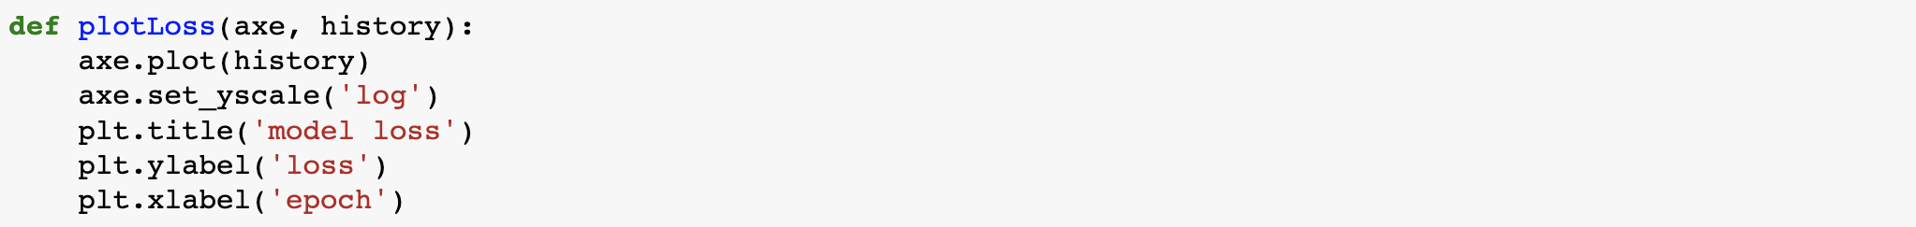
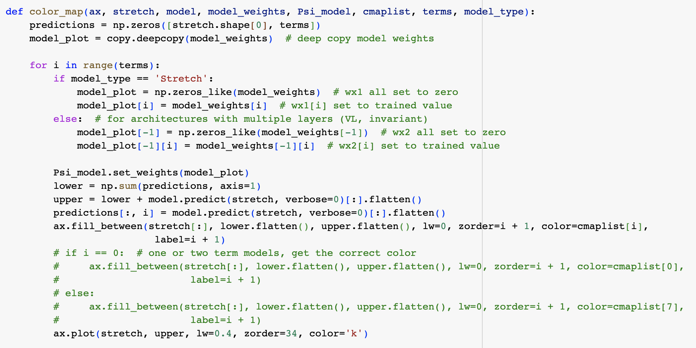
5. Plot functions
make weights all zero
plot each term’s contribution

Slide 25
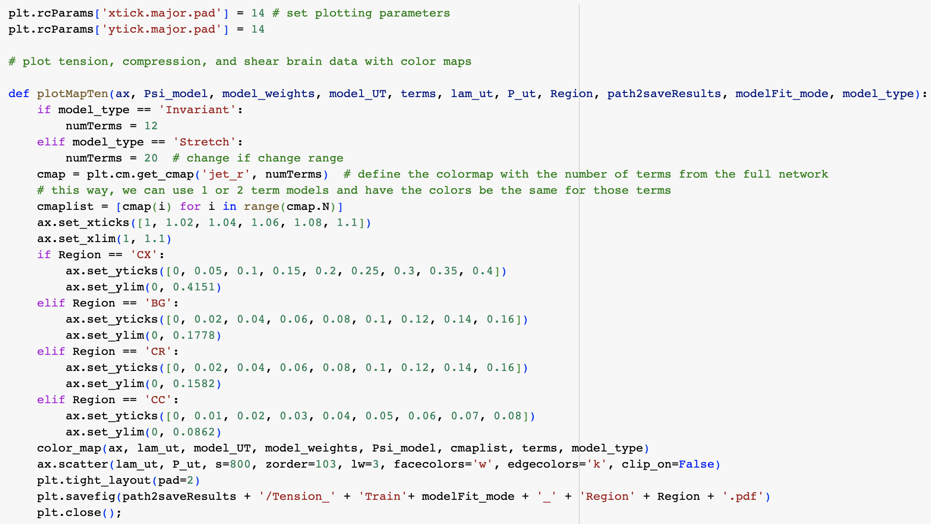
get the colormap, set axis limits and layouts, save figure

Slide 26
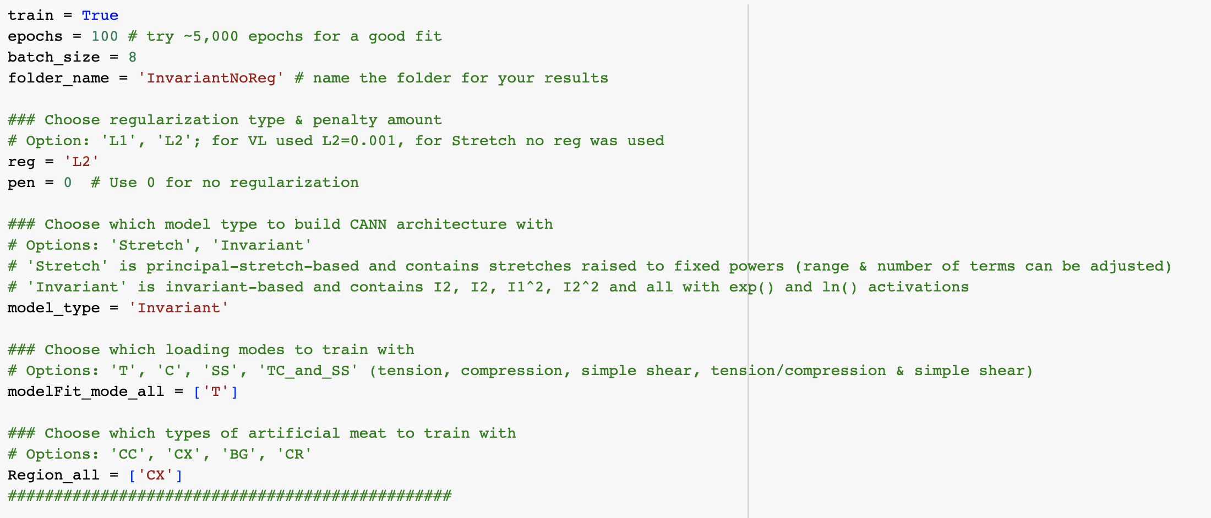
6. Model training – user parameters

Slide 27
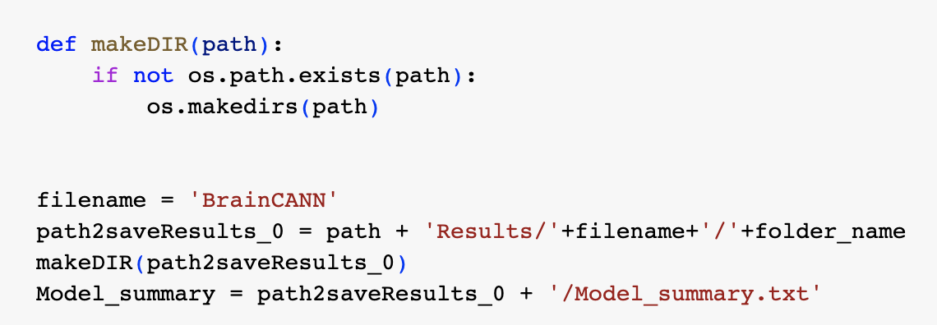
make file directories to save results and trained models
will go to wherever `path’ directs to (from beginning of code)

Slide 28
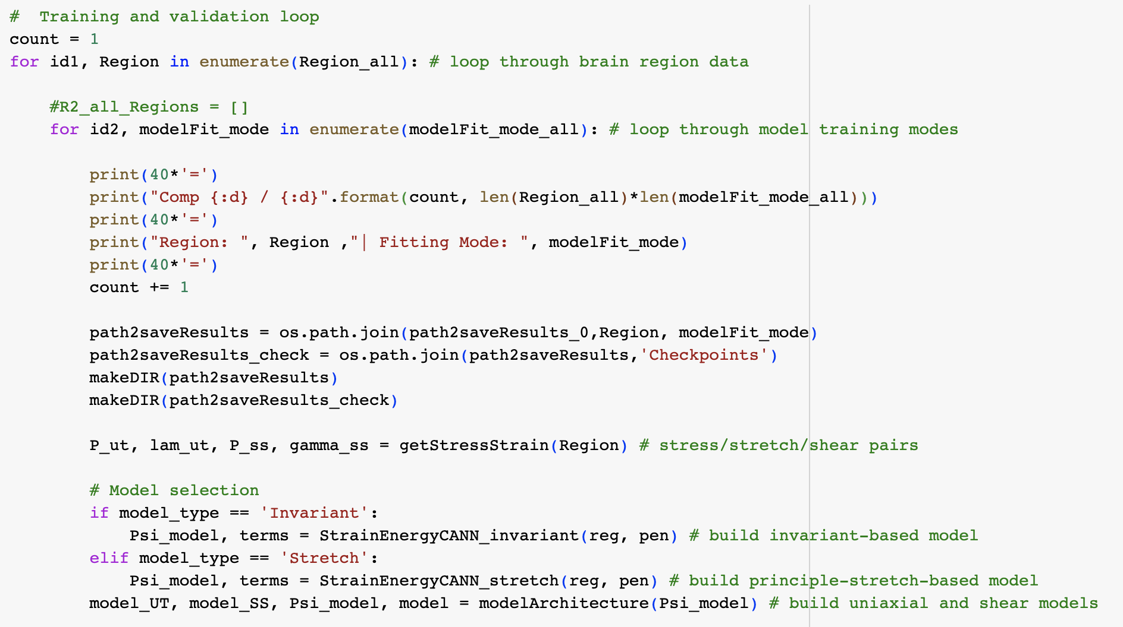
Putting it all together
loop through regions and loading modes (sets of training data)
all data for a given brain region
1. Get stress/stretch pairs. 2. Build invariant or stretch-based model. 3. Build uniaxial and simple shear models

Slide 29
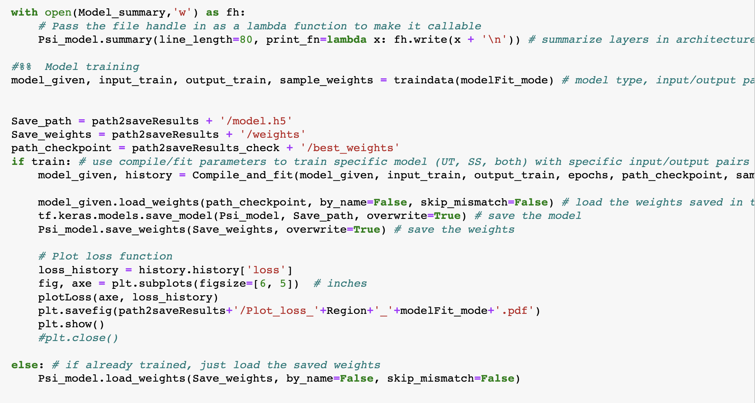
4. Determine the correct training data and model type (SS, UT). 5. Compile & fit model. 6. Plot loss
saves summary of model architecture (what layers are built)
get input/output data, sample weights, and assign correct model type (SS or UT)
compile & fit data
load best saved model weights
plot the loss
load pre-trained weights

Slide 30
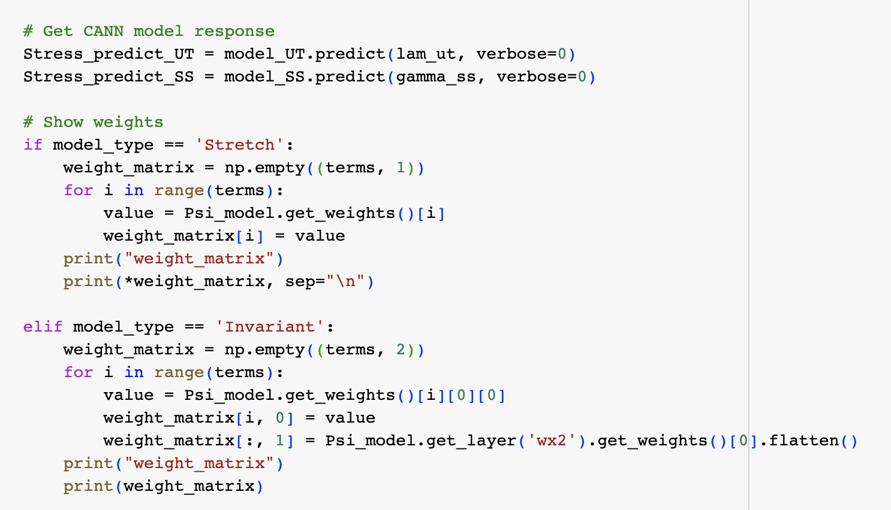
7. model.predict to get stress prediction. 8. Print out the trained weights

Slide 31
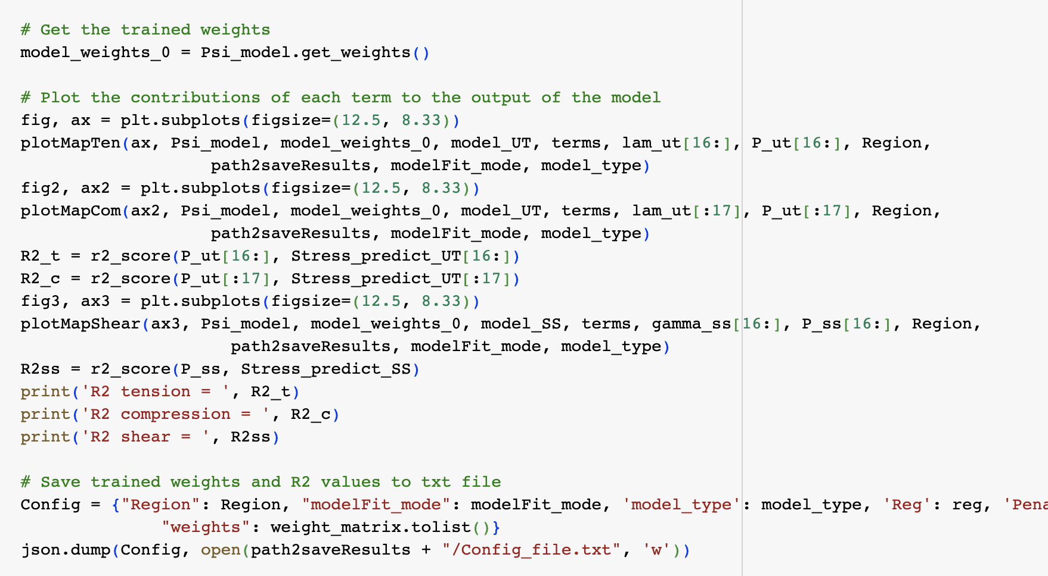
9. Get the trained weights. 10. Plot the results. 11. Find the R² between actual and predicted. 12. Save weights and R² values

Slide 32
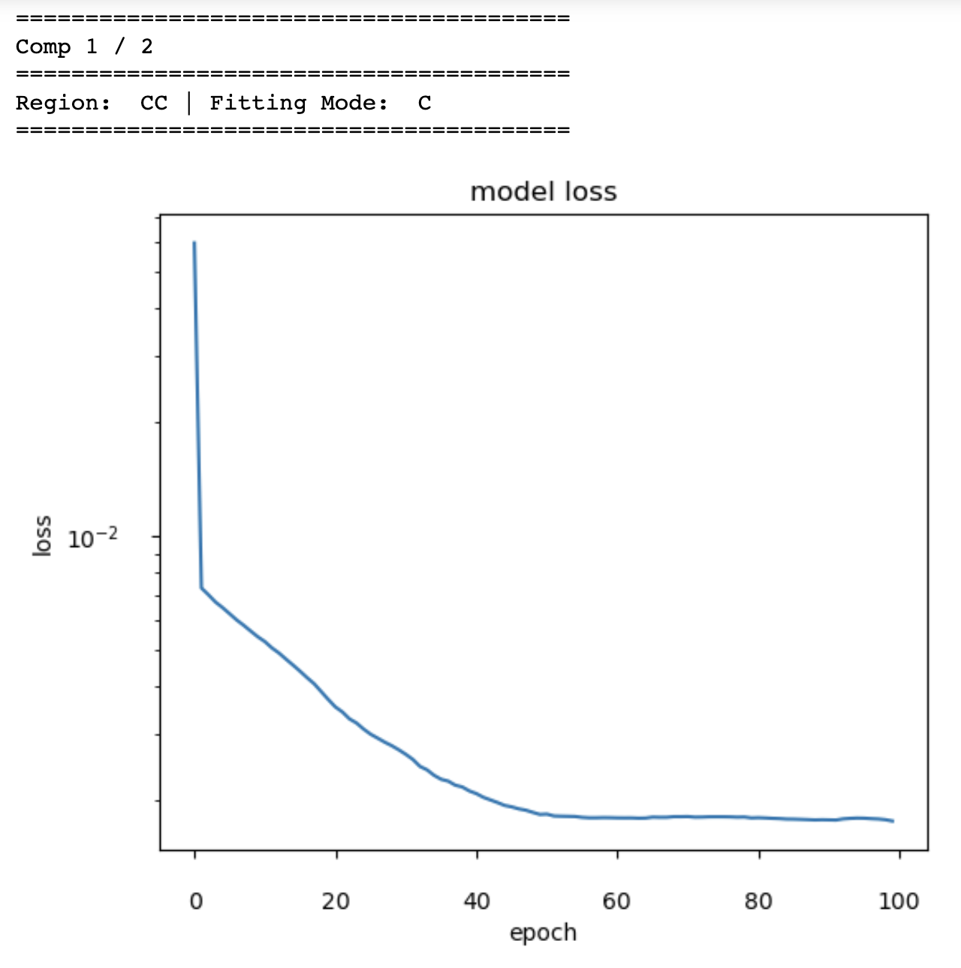
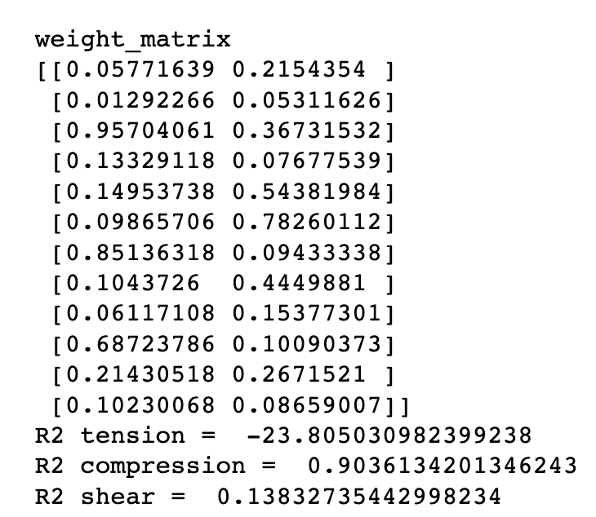
Expected results

Slide 33
Putting the figures all together
tension
compression
shear
legend

Slide 34
Challenges
Play with # of epochs
Look at different brain regions
Switch between invariant and stretch-based models
Constrain the stretch-based model to just the Mooney Rivlin model (stretch powers: +2 and -2) or the neo-Hooke (+2) or Blatz Ko model (-2). Note: the color bar will change because the number of terms changes
Need to uncomment part of the plotting code and use the correct index to get the same colors
If you have your own data: put it in the same format as the provided excel sheet, change the plotting ranges, and try running the model

